Slide 1

SENTIMENTAL ANALYSIS OF MOVIES AND WEB SERIES REVIEW USING MACHINE LEARNING ALGORITHMS

Slide 2
Corresponding Authors
Parshotam
Saurabh Gupta
Rishik Gupta
Yash Chinchole
Nishant Kumar
Ankit Rawat

Slide 3
Introduction
Application of natural language processing (NLP) and machine learning.
Sentiment analysis is a powerful technique used to analyze and understand human emotions and opinions.
Movie reviews play a crucial role in influencing people's movie-watching decisions.
For movie enthusiasts, sentiment analysis of movie reviews offers a convenient way to quickly assess the general sentiment towards a film before watching it.
Understanding audience reactions for filmmakers, production companies, and distributors
Predicting box-office success and identifying areas for improvement

Slide 4
PROPOSED APPLICATION FLOW CHART
Collecting the dataset
Data preprocessing
Text mining
Performing Sentimental Analysis using different classification algorithm
Comparision between the accuracies of different models
Final result according to the analysis

Slide 5
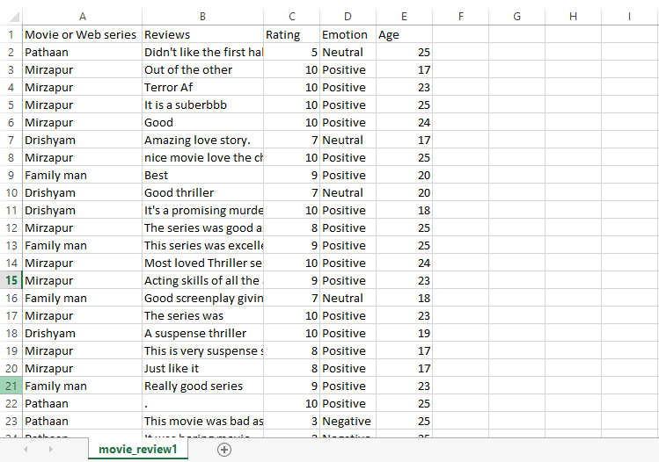
Data Collection
We have collected the data from the students of different streams of our university and we used Google form for the same.
It contains various factor of movies and web series like-
Ratings
Emotions
Reviews

Slide 6
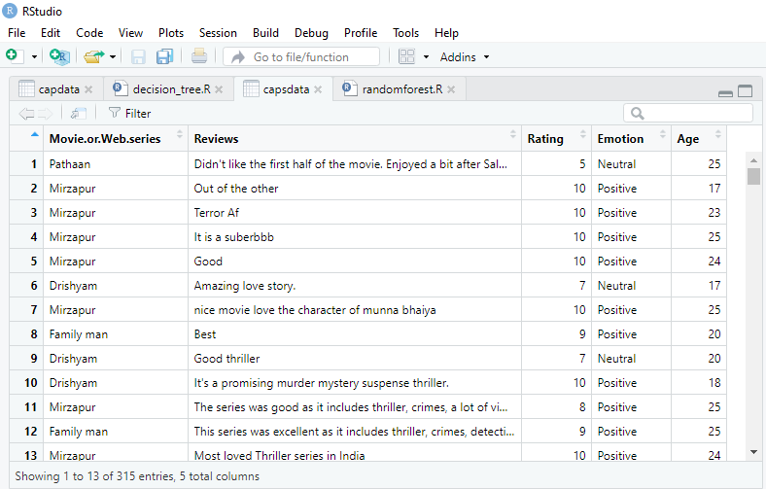
Data Preprocessing

Slide 7
Algorithms Used
NLP & Random Forest
K Nearest Neighbor
Naive Bayes
Support Vector Machine
Decision Tree

Slide 8
NLP And Random forest
NLP:
NLP is a branch of artificial intelligence that focuses on enabling computers to understand, interpret, and process human language.
It involves techniques for analyzing and manipulating text data, including tasks like sentiment analysis, text classification, named entity recognition, and machine translation.
NLP techniques include tokenization (breaking text into smaller units), stemming and lemmatization (reducing words to their base forms), and removing stopwords (commonly occurring words with little semantic meaning).
Random Forest:
Random Forest is an ensemble learning algorithm that combines multiple decision trees to make predictions or classifications.
It constructs a set of decision trees by randomly selecting subsets of the training data and features at each tree's node.
Each decision tree in the ensemble independently predicts the target variable, and the final prediction is determined by aggregating the predictions from all the trees.

Slide 9
Decision Tree
A decision tree is a popular machine learning algorithm that is used for classification and regression tasks.
It is a flowchart-like structure where each internal node represents a feature or attribute, each branch represents a decision rule, and each leaf node represents the outcome or prediction.
Decision trees have several advantages, including interpretability, as the tree structure can be easily visualized and understood. They can handle both numerical and categorical features and can capture non-linear relationships in the data.
The algorithm is called a decision tree because it mimics the structure of a tree with branches and leaves.

Slide 10
SVM(Support Vector Machine)
In machine learning, Support vector machine(SVM) are supervised learning models with associated learning algorithms that analyze data used for classification and regression analysis. It is mostly used in classification problems.
In this algorithm, each data item is plotted as a point in n-dimensional space.
With the value of each feature being the value of a particular coordinate.
Then, classification is performed by finding the hyper-plane that best differentiates the two classes.
The goal of a SVM is to create a flat boundary called a hyperplane, which divides the space to create fairly homogeneous partitions on either side.

Slide 11
K-NN(K Nearest Neighbor)
KNN Algorithm: KNN is a non-parametric and instance-based learning algorithm. It does not make any assumptions about the underlying data distribution and instead stores the entire training dataset as the model.
Nearest Neighbor Classification: In KNN classification, the algorithm predicts the class label of a new data point by examining the classes of its k nearest neighbors in the training dataset. The value of k is a hyperparameter that needs to be set prior to training.
Distance Metric: To determine the nearest neighbors, KNN uses a distance metric such as Euclidean distance or Manhattan distance to calculate the proximity between data points in the feature space. The choice of distance metric depends on the nature of the data and the problem at hand.

Slide 12
Naive Bayes
Bayes' Theorem: Naive Bayes is based on Bayes' theorem, which describes the probability of an event occurring given prior knowledge or evidence. It calculates the posterior probability of a class label given the features of an input data point.
Naive Assumption: The "naive" assumption in Naive Bayes is that features are conditionally independent of each other given the class label. Although this assumption is often violated in real-world data, Naive Bayes can still perform well and is computationally efficient.
Classification Rule: To classify a new data point, Naive Bayes applies the maximum a posteriori (MAP) decision rule. It selects the class label with the highest posterior probability given the input features. This decision rule is based on the assumption that the class label with the highest probability is the most likely one.
Naive Bayes is known for its simplicity, scalability, and ability to handle high-dimensional data efficiently.

Slide 13
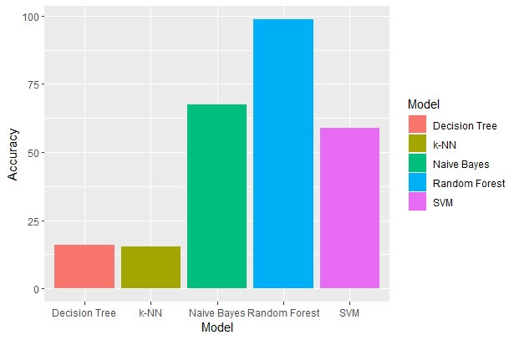
Comparision between accuracies of different models
Sr. no. | Model | Accuracy
1. | Random Forest | 98.72611
2. | K-NN | 15.28662
3. | Decision Tree | 15.87214
4. | SVM | 58.94737
5. | Naïve Bayes | 67.51

Slide 14
Conclusion
In conclusion this work investigated the application of machine learning algorithms for sentimental analysis on movie reviews.
We have shown that these techniques have the capacity to properly identify the varied feelings of students about newly generated movies/series.
Our findings emphasize the necessity of building more robust and accurate machine learning models for viewing diverse moods, which may assist filmmakers in working on new projects and up-skilling their potential.

Slide 15
THANK YOU

